Slide 1
IEEE 802.11ba
Wake-Up Radio
Solving IoT's Power Paradox

Slide 2
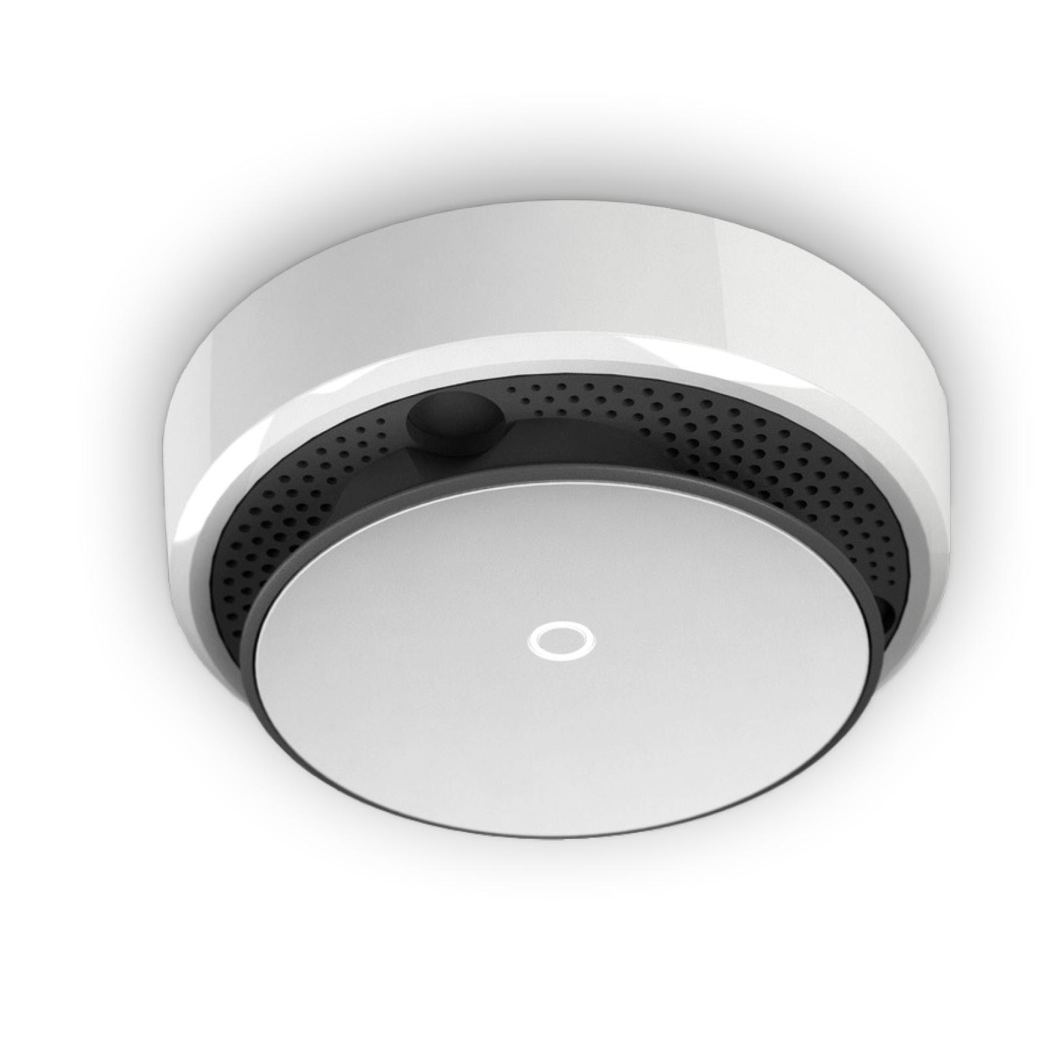
THE PROBLEM
A $120 Smart Smoke Detector
$120
Features
Connects to WiFi, detects smoke, sends notifications to your phone—everything you'd expect from a modern IoT device.
The Fatal Flaw
When the battery dies, you cannot replace OR recharge it.
The real power drainer? The Radio Device (WIFI).

Slide 3
THE CHALLENGE
The Engineering Tradeoff
IEEE 802.15.4 Standard
A low-power wireless standard designed for IoT devices.
Data Rate
Range
250 kbps
ّّ~ 10 meters
Maximum speed
Not enough for a house
The Fundamental Tradeoff
"The more transmission power you use, the longer your range. But more power drains your battery faster. You cannot have both high energy efficiency AND high data rates with a single radio ."
VS
Energy Efficiency
High Performance

Slide 4
THE BREAKTHROUGH
Let There Be No Signle Radios
If one radio can't do it...
+
Use TWO radios!

Slide 5
CHAPTER 01
WUR Radio
High-Level Architecture

Slide 6
PRIMARY RADIO
PCR: Primary Connectivity Radio
High Speed Data Transmission
Capable of handling large data payloads at high speeds
High Power Consumption
Requires significant energy to maintain connectivity
High Range
Covers large distances throughout your entire home
PCR
Must sleep to save power—but who wakes it up?

Slide 7
COMPANION RADIO
CCR/WUR: The Wake-Up Radio
Extremely Low Power
Consumes less than 1 mW —negligible energy footprint
Always Awake
Never sleeps—constantly listening for incoming signals
Receiver Only
Cannot transmit—dedicated purely to listening
WUR
One Job: Wake Up PCR
Detects wake-up frames and physically signals the PCR to power on

Slide 8
WORKFLOW
How They Work Together
Scene: 1 AP (WiFi Router) + 1 STA (Your Device with 2 Radios)
1
2
3
4
AP sends wake-up frame
WUR signals PCR: "Wake up!"
AP has data to send
WUR detects frame
PCR asleep
To WUR
Always on
Physical signal
5
6
7
PCR goes back to sleep
PCR powers on
AP sends data to PCR
"I'm ready"
High speed
Save power
The PCR only consumes power when actively transmitting data—otherwise, it's asleep!

Slide 9
CHAPTER 02
IEEE 802.11ba
Standard
Technical Implementation

Slide 10
STANDARDIZATION
IEEE 802.11ba Evolution
2017
First Draft Released
Initial specification for Wake-Up Radio technology introduced to IEEE working group
2018-2020
Draft Iterations
Multiple revisions and refinements based on industry feedback and testing
2021
Official Release
IEEE 802.11ba officially published and ready for industry adoption

Slide 11
POWER OPTIMIZATION
Duty Cycling: Let WUR Sleep Too
The WUR's "Work Day"
Awake
Sleeping
...
Awake
Sleeping
1
Minimum Wake-Up Time
2
Duty Cycle Period
Minimum duration WUR must stay awake during a duty cycle
How long is one complete work day (awake + sleep)
3
Length of "Awake" Period
4
Starting Time of "Awake" Period
How long does WUR stay awake during a work day
When does the awake period begin (synchronization)
The Negotiation Process
1
2
3
AP advertises Min Wake-Up Time
STA replies with Duty Cycle & Awake Length
AP replies with Starting Time
Negotiation Complete!

Slide 12
SYNCHRONIZATION
WUR Beacon: Maintaining Connection
Normal 802.11
WUR Solution
Beacon Frames
WUR Beacon Frame
AP broadcasts periodically with 64-bit timestamp
New frame type introduced specifically for wake-up radios
Synchronize all devices to common clock
AP periodically transmits WUR beacons
Heartbeat: "You're still connected"
Provides "heartbeat" function
Compressed timestamp (not 64-bit)
Problem: PCR loses sync when asleep!
Compressed format saves transmission time—WUR needs to sleep!

Slide 13
NETWORK MAINTENANCE
Re-Discovery: Finding Your AP
Normal 802.11
If device stops receiving beacon frames, it assumes it's out of range and needs to find a new AP.
Re-Discovery Process:
1
Scan ALL available channels
2
Find one or more APs
3
Authenticate with AP
4
Associate with BSS
Extremely power hungry!

Slide 14
NETWORK MAINTENANCE
Re-Discovery: Finding Your AP
WUR Solution
Engineer's optimization: Dedicate a single channel for discovery instead of scanning all channels.
All APs send WUR Discovery Frames
Contains: AP address + operating channel
Device monitors ONE channel only
It picks one AP to authenticate and associate to

Slide 15
Wake-Up Radio technology breaks the fundamental power-range tradeoff , enabling always-connected devices that last for years on a single battery.
IEEE 802.11ba represents a paradigm shift in wireless communication design
Ultra Low Power
Full Range
Years of Life
<1 mW consumption
Whole-home coverage
Extended battery life

Slide 16
References
1
Deng, D.-J., Lien, S.-Y., Lin, C.-C., Gan, M., & Chen, H.-C. (2020).
IEEE 802.11ba wake-up radio: Performance evaluation and practical designs.
https://doi.org/10.1109/ACCESS.2020.3013023
Google Nest Protect Technical Specs
https://support.google.com/googlenest/answer/9229922?hl=en#zippy=%2Cnd-gen-nest-protect
2

